Slide 1
Lesson objective
Need whiteboards and calculators.
Title: Volume
Aim – be able to:
Substitute into formula to solve volume
Determine volume of other prisms
Plan:
Review substitution
Identifying shapes
Volume of prisms

Slide 2
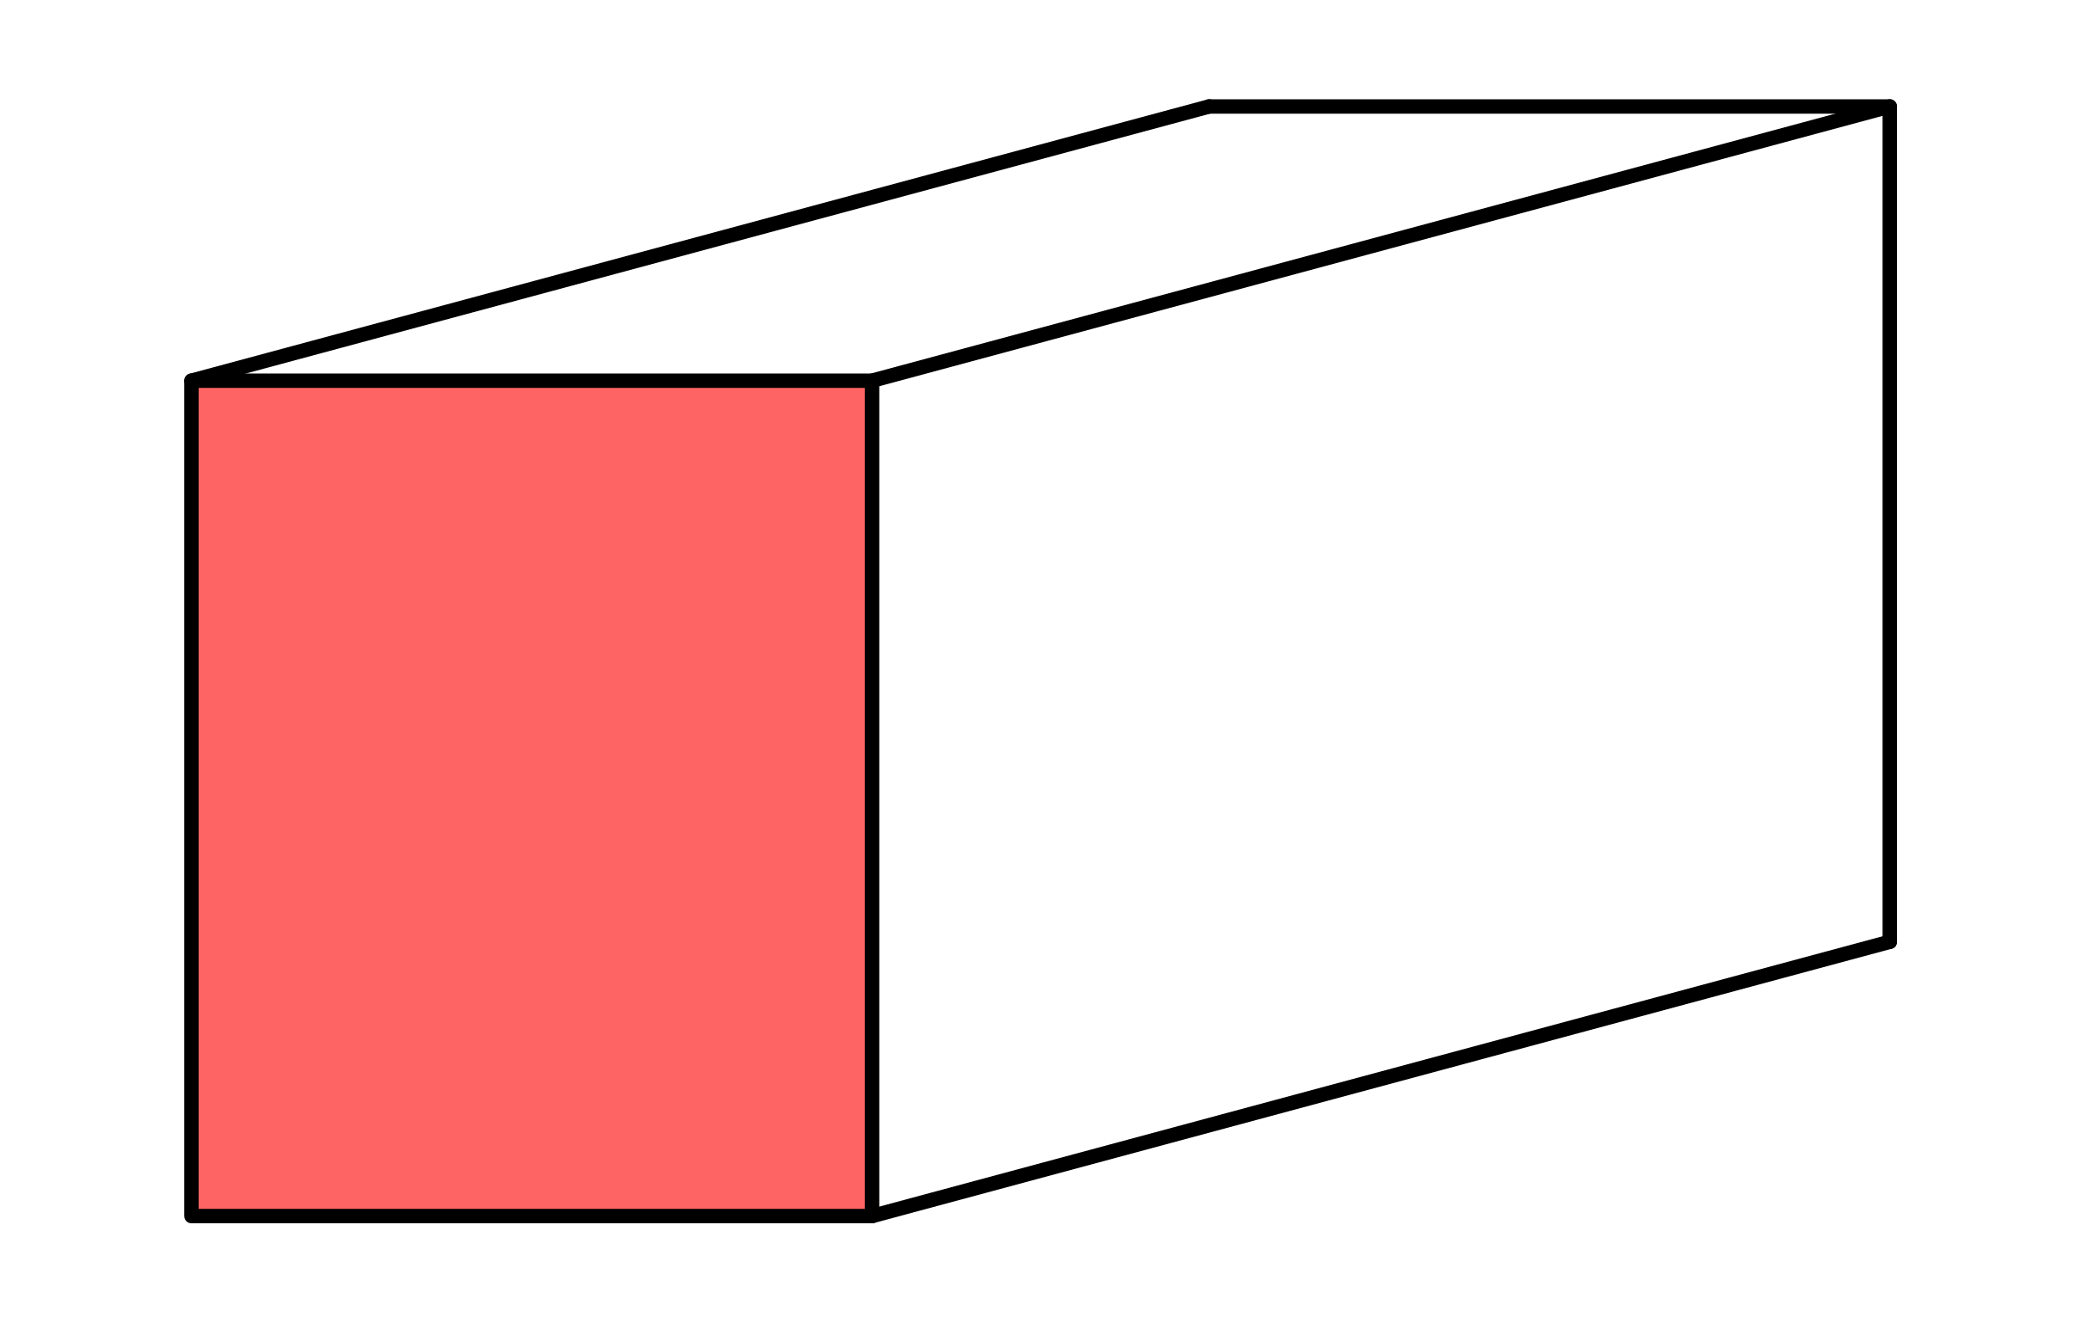
Whiteboards
Diagram
Rule:
Numbers:
Solve:
8cm
11cm
6cm

Slide 3
Whiteboards
Diagram
Rule:
Numbers:
Solve:
3m
20m
^{4m}

Slide 4
Whiteboards
Diagram
Rule:
Numbers:
Solve:
10mm
30mm
16mm

Slide 5
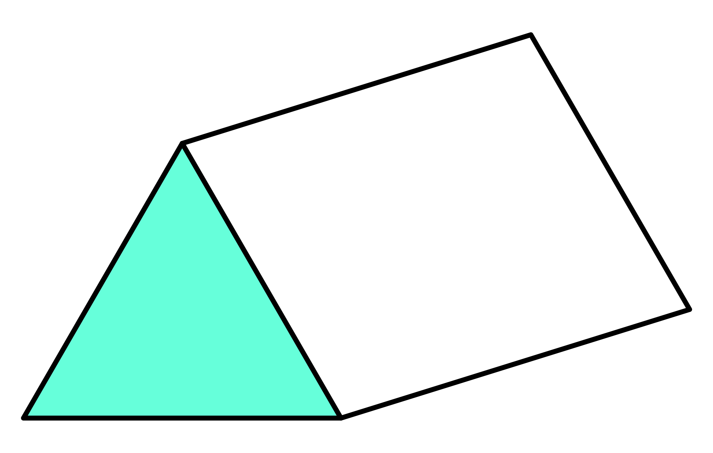
Whiteboards
Diagram
Rule:
Numbers:
Solve:
8m
10m
5.2m

Slide 6
Whiteboards
Diagram
Rule:
Numbers:
Solve:
1.6m
300cm
100cm

Slide 7

Worthy of note(s)
It is because of this conversion that we should note:
$${1cm}^{3}=1mL$$
$$1000mL=1 L$$
$${1000cm}^{3}=1L$$
$${1m}^{3}=1000L=1kL$$
kL means kilolitre (kilo meaning a thousand)

Slide 8
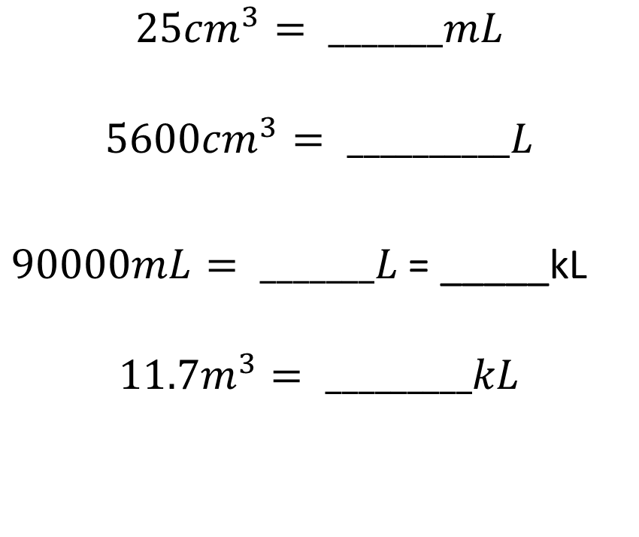
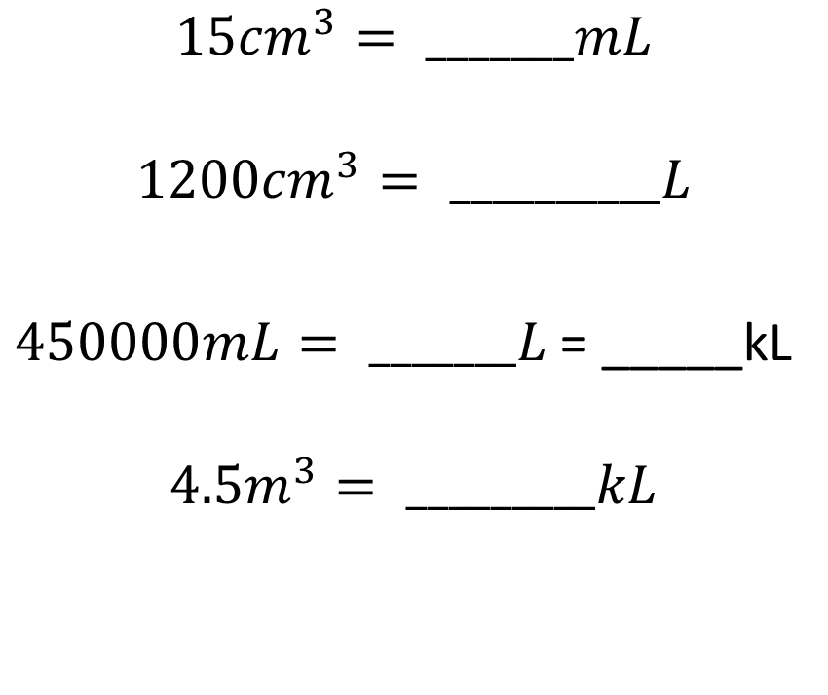

I do / we do
$${1cm}^{3}=1mL$$
$$1000mL=1 L$$
$${1000cm}^{3}=1L$$
$${1m}^{3}=1000L=1kL$$
$${15cm}^{3}= _______mL$$
$${1200cm}^{3}= __________L$$
$450000mL= _______L$ = _____kL
$${4.5m}^{3}= _________kL$$
$${25cm}^{3}= _______mL$$
$${5600cm}^{3}= __________L$$
$90000mL= _______L$ = _____kL
$${11.7m}^{3}= _________kL$$

Slide 9
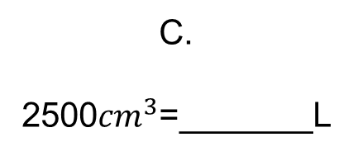
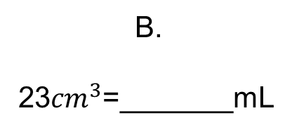
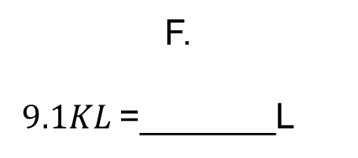
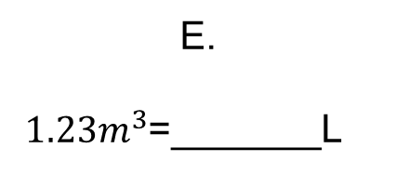
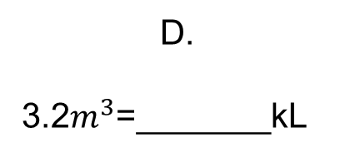
Split your whiteboards into 6 sections like below.
A.
1230mL=_______L
B.
23${cm}^{3}$=_______mL
C.
2500${cm}^{3}$=_______L
1.23
23
2.5
D.
3.2$m^{3}$=_______kL
E.
$1.23m^{3}$=_______L
F.
$9.1KL$=_______L
3.2
1230
9100

Slide 10
Whiteboards
How many Liters are in this rectangular prism?
Diagram
Rule:
Numbers:
Solve:
3m
20m
^{4m}

Slide 11
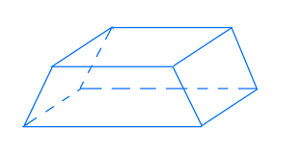
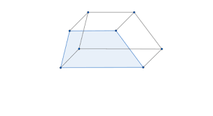

Trapezium prism
5cm
I do
3cm
What’s the rule?
R: $A=\frac{\left(a+b\right)}{2} ×h$
N:
S:
8cm
11cm
You do
4cm
6cm
5cm
8cm

Slide 12
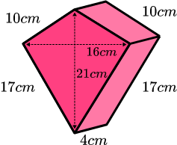

Kite prism
D:
R: $\frac{a×b }{2}×l$
N
S:

Slide 13
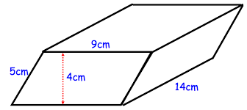

Parallelogram prism
D:
R: $b×h×l$
N:
S:
How much water can this hold?

Slide 14
Individual practice
HAESE 8
Page 186
Questions 5 – 9

Slide 15
Reflect – fist to 5
Aim – be able to:
Substitute into formula to solve volume
Determine volume of other prisms

